Slide 1

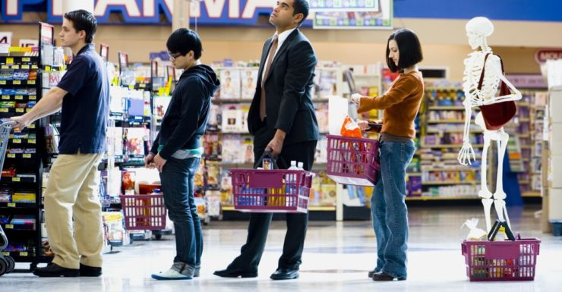
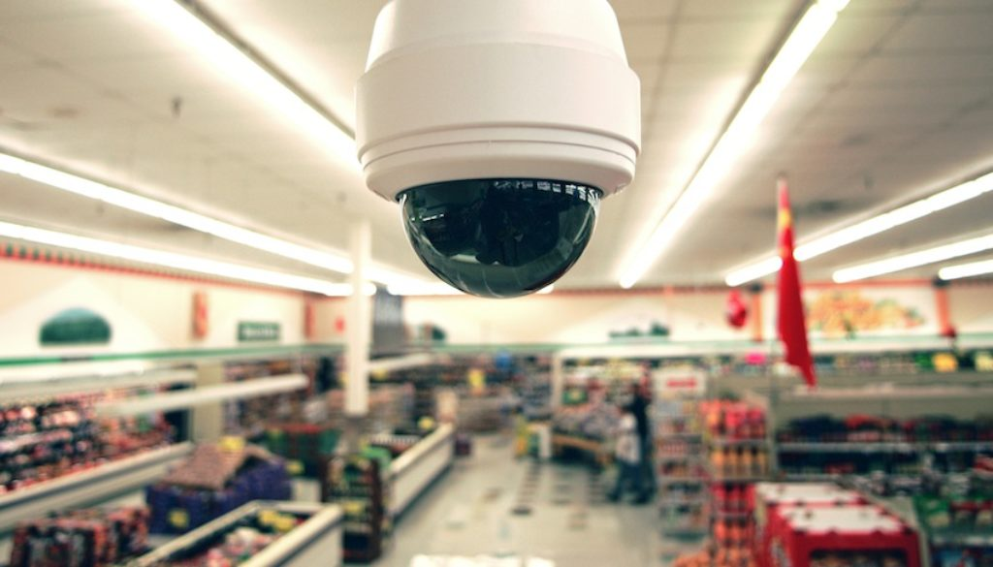

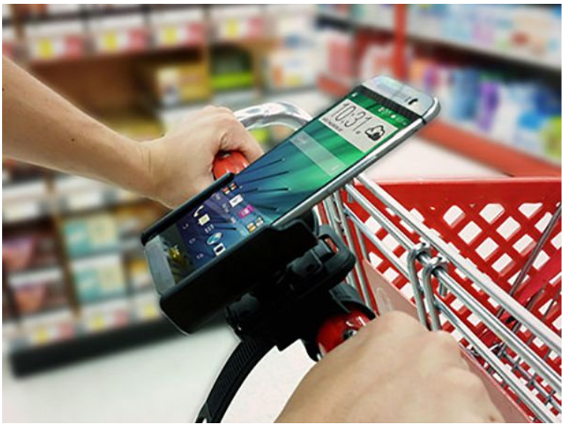

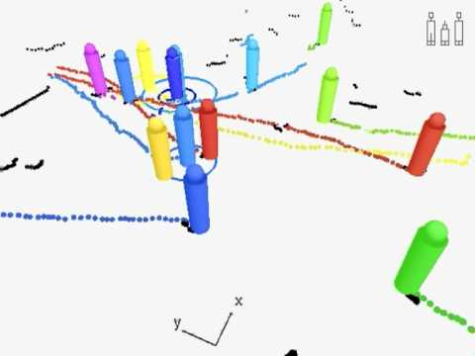
SECURITY CAMERAS
CASHIERS
QUEUE PREDICTION
IMAGE OF A FRAME DETECTING PEOPLE
SHOP IMAGE → WITH ONE PERSON
MOBILE APP
CUSTOMERS
TRACK PEOPLE

